Slide 1
إدارة المشروعات Projects Management
د. باسم ممدوح الحلوانى
Lecture 5
Time Management
(Scheduling)

Slide 2
Time Management
A range of skills, tools, and techniques used to manage time when accomplishing specific tasks, projects and goals
Importance of Project Schedules:
Managers often cite delivering projects on time as one of their biggest challenges
Schedule issues are the main reason for conflicts on projects, especially during the second half of projects
Time has the least amount of flexibility; it passes no matter what happens on a project

Slide 3
Individual Work Styles and Cultural Differences
Cause Schedule Conflicts
peoples’ attitudes toward structure and deadline are different:
Judgment type people: prefer to follow schedules, meet deadlines and have closure
Perception type people: prefer to keep things open and flexible; deadlines are a signal to start rather than to complete a project
Difference cultures and even entire countries have different attitudes about schedules

Slide 4
Effects of Poor Time Management
Decreased employee morale
Employees do not like working for managers that do not know how to manage their time.
When managers react without first planning, the employees see this as a weakness in management skills.
Lower Employee Productivity
With low morale and a lack of trust in their supervisor/manager, employees tend to perform less than usual.
High Turnover
As morale gets lower and productivity declines, employees lose interest/desire to work for the manager/company.
This cost companies a lot of money to consistently train new employees.

Slide 5
Project Time Management Processes
Process Group | Integration Management Process | Major Output
Planning | P1: Defining Activities | Activity List
 | P2: Sequence Activities | Project Schedule Network Diagram
 | P3: Estimate Activity Resources | Activity Resource Reqs.
 | P4: Estimate Activity Duration | Activity Duration Estimates
 | P5: Develop Schedule | Project Schedule
Monitoring and Controlling | MC1: Control Schedule | Work Performance Measurements

Slide 6
Project Time Management Processes
The basis for creating a project schedule is derived from four project time management processes:
Activity definition
Activity sequencing
Activity resource Estimation and
Activity duration Estimation (further defining the time and cost)

Slide 7
P1: Defining Activity
An activity or task is an element of work normally found on the work breakdown structure (WBS) that has an expected duration, a cost, and resource requirements
Activity definition involves developing a more detailed WBS and supporting explanations to understand all the work to be done so you can develop realistic cost and duration estimates
Project schedules grow out of the basic documents that initiate a project
Project charter: includes start and end dates and budget information
Scope statement and WBS: help define what will be done
Input
1) Scope Baseline 2) Enterprise Environment Factors 3) Organizational Process Assets
Tools/Techniques
1) Decomposition 2) Component Planning 3) Expert Judgment
Output
1) Activity List 2) Activity Attributes 3) Milestone List

Slide 8
Project Time Management Processes
Activity Lists
An activity list is a tabulation of activities to be included on a project schedule that includes:
The activity name
An activity identifier or number
A brief description of the activity
Activity Attributes:
provide more information such as:
Predecessors,
Successors,
logical relationships,
leads and lags
Resource requirements,
Constraints,
Imposed dates, and
Assumptions related to the activity

Slide 9
Project Time Management Processes
Milestones
A milestone is a significant event that normally has no duration
Not every deliverable or output created for a project is a milestone
It often takes several activities and a lot of work to complete a milestone
They’re useful tools for setting schedule goals and monitoring progress
Examples include obtaining customer sign-off on key documents or completion of specific products such as software modules or the installation of new hardware

Slide 10
P2: Sequencing Activities
After defining project activities, the next step is activity sequencing
Involves reviewing activities and determining dependencies
A dependency or relationship is the sequencing of project activities or tasks
Does a certain activity have to be finished before another can start?
Can the project team do several activities in parallel?
Can some overlap?
Determining these relationships or dependencies among activities has a significant impact on developing and managing a project schedule.
You must determine dependencies in order to use critical path analysis

Slide 11
P2: Sequencing Activities
Three types of Dependencies
Mandatory dependencies: inherent in the nature of the work being performed on a project, sometimes referred to as hard logic
For example, you cannot test code until after the code is written
Discretionary dependencies: (متروك للتقدير)
defined by the project team., sometimes referred to as soft logic and should be used with care since they may limit later scheduling options
For example, we might follow good practice and not start the detailed design of a new system until the users sign off on all of the analysis work.
External dependencies: involve relationships between project and non-project activities
For example, the installation of a new OS/software may depend on delivery of new hardware from an external supplier.

Slide 12
P2: Sequencing Activities
it is important that project stakeholders work together to define the activity dependencies in their project.
If you do not define the sequence of activities, you cannot use some of the most powerful scheduling tools available to project managers: network diagrams and critical path analysis.
Input
1) Activity List & Attributes 2) Milestone List 3) Scope Statement 4) Org Process Assets
Tools/Techniques
1) Determine Dependency 2) PDM 3) Apply Leads/Lags 4) Schedule Network
Output
Project Schedule Network Diagrams Update Project Docs

Slide 13
P2: Sequencing Activities
Network diagrams
Network diagrams are the preferred technique for showing activity sequencing
A network diagram is a schematic display of the logical relationships among, or sequencing of, project activities
Some people refer to network diagrams as project schedule network diagrams or PERT charts (PERT is described )
Two main formats are the arrow and precedence diagramming methods:
Activity-on-arrow (AOA) or Arrow Diagramming Method (ADM)
Precedence Diagramming Method (PDM)

Slide 14
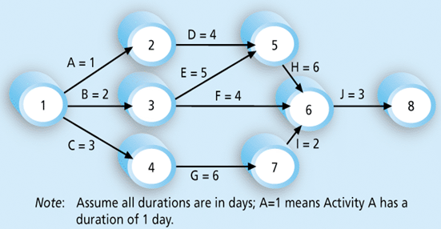
P2: Sequencing Activities
Network diagrams
Activity-on-arrow (AOA) or Arrow Diagramming Method (ADM)
Activities required to complete the project are represented by arrows (A to J).
These activities come from the WBS and activity definition process described earlier.
Nodes or circles are the starting and ending points of activities.
The first node signifies the start of a project, and the last node represents the end.

Slide 15
P2: Sequencing Activities
Network diagrams
Activity-on-arrow (AOA) or Arrow Diagramming Method (ADM)
Every activity on the network diagram must be completed in order to finish the project.
Not every item on WBS needs to be shown on the network diagram (only activities with dependencies need to be shown).
However, some people like to have start and end milestones and to list every activity (It is a matter of preference)
For large projects with hundreds of activities, it might be simpler to include only activities with dependencies on a network diagram.
Sometimes it is enough to break down the project into several smaller network diagrams.

Slide 16
P2: Sequencing Activities
Steps to create an Activity-on-arrow (AOA) network diagram:
Find all of the activities that start at Node 1. Draw their finish nodes, and draw arrows between Node 1 and each of the finish nodes.
Put arrowheads on all arrows to signify the direction of the relationships.
Put the activity letter or name on the associated arrow.
If you have a duration estimate, write it next to the activity letter or name, as shown in Figure (example, A = 1 means that the duration of Activity A is one day, week, or other standard unit of time).
Continue drawing the network diagram, working from left to right.
Look for bursts and merges:
A Bursts occur when two or more activities follow a single node (Node 1 is a burst because it goes into Nodes 2, 3, and 4).
A merge occurs when two or more nodes precede a single node(Node 5 is a merge preceded by Nodes 2 and 3).
Continue drawing the AOA network diagram until all activities are included.

Slide 17
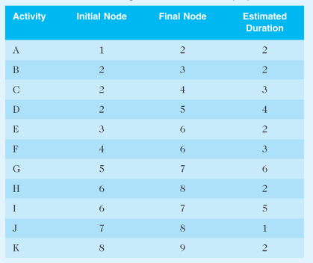
P2: Sequencing Activities
Excersie
Consider the Table shown, All duration estimates are in days, and the network proceeds from Node 1 to Node 9
Draw an AOA network diagram representing the project.
Determine the Burst and Merge Nodes.
Estimate the finish date assuming beginning of the project today?

Slide 18
P2: Sequencing Activities
Network diagrams
Activity-on-arrow (AOA) or Arrow Diagramming Method (ADM)
Even though AOA or ADM network diagrams are generally easy to understand and create, a different method is more commonly used:
The precedence diagramming method (PDM)

Slide 19
Thank you for Listening

